Slide 1
Restaurant Data Analysis

Slide 2
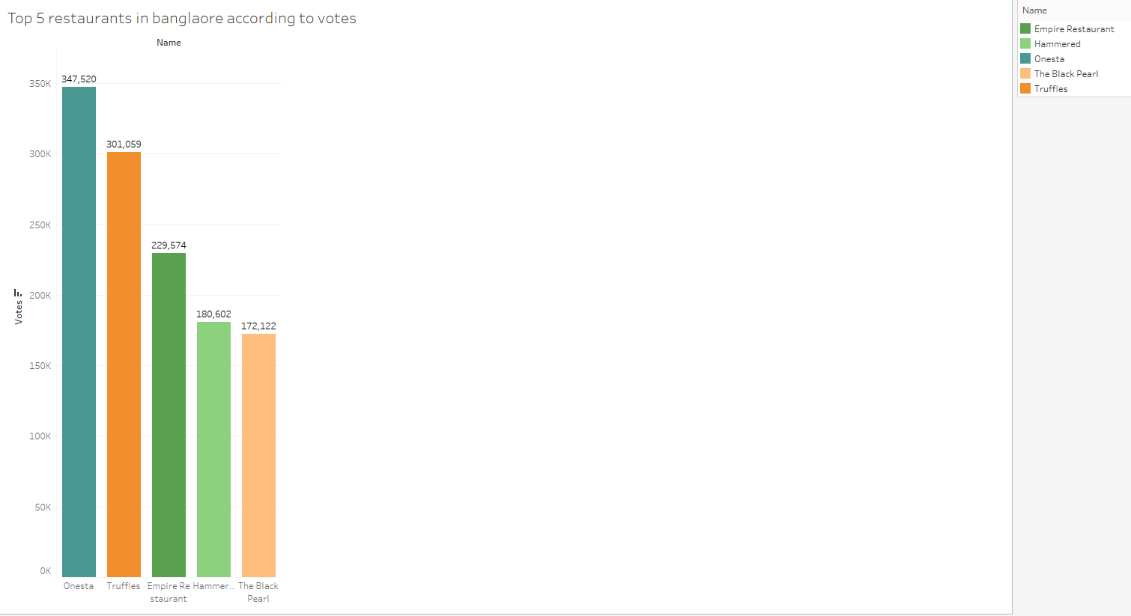
Top 5 Restaurants in Bangalore according to votes
Restaurants with the top votes is Onesta with 347,529 votes and second comes Truffles with 301,059 votes

Slide 3
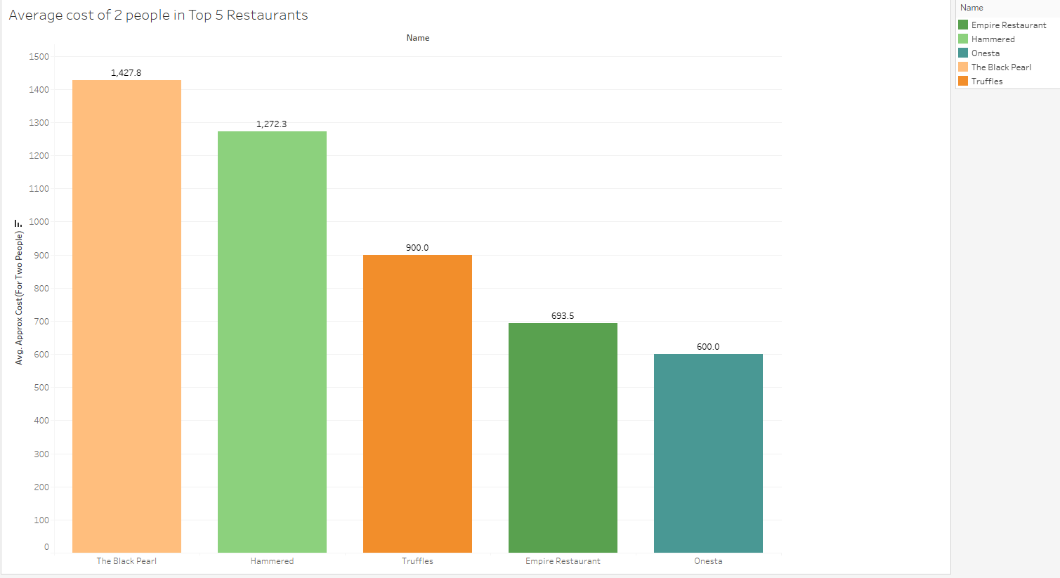
Average cost of 2 people in Top 5 Restaurants
Black pearl has the mots expensive cost for 2 people with average amount of 1427, lowest is the Onesta which is also the topper in the votes section with the avearge cost of 600 for two people .

Slide 4
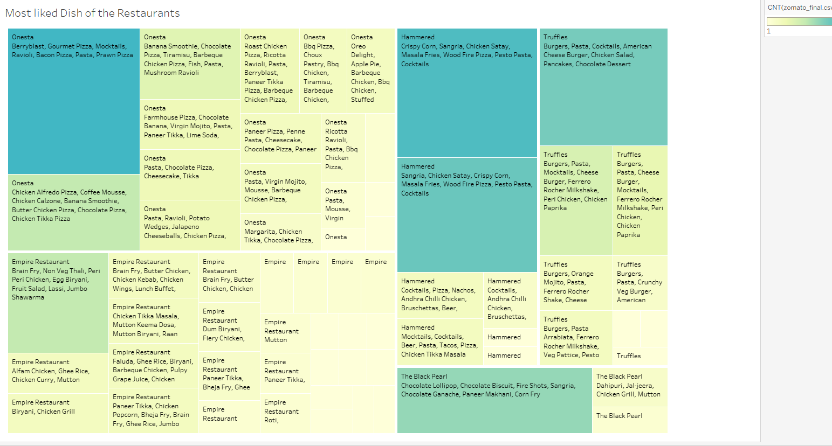
Most Liked Dishes Of The Restaurant
These are the most liked dishes of the top restaurants in Bangalore order wised.

Slide 5
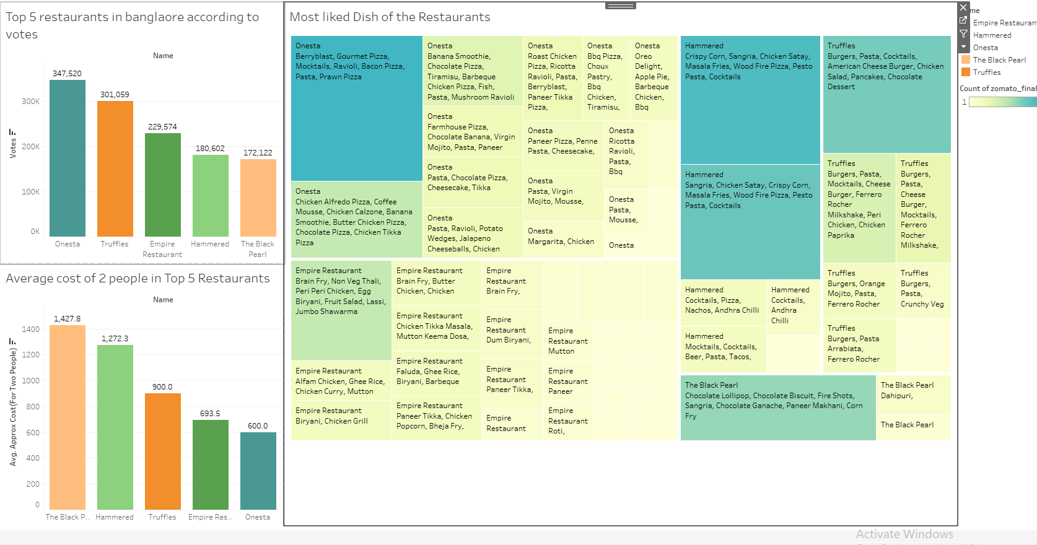
DASHBOARD

Slide 6
What should be the hiring process for the people you need to run your restaurant business?
You need to analyze the need and talk to various department heads like the manager, sous chef, etc. and ask them if any extra help is needed.
Check your budget and requirements and then go ahead and determine the number of people you can hire and how much you’ll pay them.
The number of tables you have – Number of tables you have and the average turnover helps you determine the number of servers required.
The type of restaurant setup that you have – for example, for a fine dining restaurant you generally need highly experienced head chefs but, for a quick-service restaurant, you can hire someone less experienced.
When interviewing a person, you need to see if his/her thoughts are compatible with the goals of the restaurant. Check through the previous responsibilities of the candidates. This would help you determine how dedicated the person is towards their work. The best way of identifying a suitable candidate is by checking through their application form which would be filled out neatly, and they often provide a professional and detailed resume.
The restaurant staff hiring process is a time and resource-consuming activity; therefore you should be as transparent as possible. Transparency gives a clear idea to the candidate if he/she would like to work at your restaurant.

Slide 7
Decide where you want your restaurant to be located.
Another element of market analysis relates to where your bar or restaurant is located
Other businesses in your area
Accessible for and volume of foot traffic
Other bars and restaurants near you
Accessibility from highways and interstates
Relation to business, shopping, or entertainment district
Business operations of direct bar and restaurant competition

Slide 8
What are the licenses and permits necessary to begin your restaurant business?
FSSAI License.
Liquor License.
Health/Trade License.
Eating House License.
Fire Safety License.
Lift Clearance.
Music License.
Certificate of Environmental Clearance.

Slide 9
How to optimize the installation and maintenance cost of the essential equipment required to establish a restaurant business.
Kitchen Equipment
Refrigerators and Freezers
Counters and Cutting Surfaces
Slicers
Mixers
Ovens and Ranges
Sinks
Proper Safety Equipment
Front-of-House Equipment
Menu Boards
Tablecloth and Napkins
Salt And Pepper Shakers
Operational Equipment
Be it cash-registers, credit-card processing machines, or restaurant management systems, these are being increasingly used by the restaurants to make their operations seamless.

Slide 10
What should be the concept or theme for the restaurant and who is the target audience?
A restaurant concept is the overall idea or theme that defines the restaurant. Concepts include the your menu's design, service style, dining room decor, and — of course — the style of food. Many restaurants are conceived based on a chef’s personal experiences or interests. Heritage, local ingredients, traditions, or family are all common sources of inspiration for restaurant concepts. But concepts can also be defined by a chef’s travel experience, training, or an interest in a certain area of art, science, or culture. Because food is, after all, a mixture of all those things. Read on to explore the elements of a concept, some steps to help guide your choices, and even some restaurant concept examples.
Identify what inspires you and defines you as a chef - This is easier said than done and often takes chefs an entire lifetime to figure out. Deciding the style of food that you gravitate towards the most is a good place to start. It can come from your heritage or upbringing, but it doesn’t have to.
Define your unique spin - Restaurants that offer something unique stand a much better chance of sticking around and getting customers excited about your food.
Research your customer base - It can be tough to tell exactly what type of restaurant will resonate with people in a given area, but it’s important to make sure that there is some demand for what you want to offer. Get a sense for the competition and observe where other businesses have found success. Try to think about what’s important to your prospective customers and decide what you want to communicate to them.
Develop a menu - While it’s okay to stray from traditions a little bit, it’s important to avoid conceiving dishes that are muddled or confusing. So, if you brand yourself as an Irish pub, you may want to offer all the classic staples that people will expect before they even walk in the door. But if your concept is Chinese-Mexican fusion or molecular gastronomy, you can probably get away with a lot more whimsy.
Choose a service style - Once you have your menu mostly figured out, it should be easy to pick a service style that will lend itself well to your dishes. For example, many Italian foods are great when served family style, but pricey seafood entrees might be best in a fine dining environment.

